Slide 1
Software Design for Cloud 2
Python Programming
Lecture 7
Strings

Slide 2
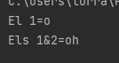
Strings – first Program
def main():
name = 'John'
print('El 1={0}'.format(name[1]))
print('Els 1&2={0}'.format(name[1:3]))
main()

Slide 3
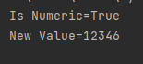
Strings – Translate from integer to String
def main():
value = '12345'
print('Is Numeric={0}'.format(value.isnumeric()))
number= int(value) # to integer
number += 1
value2= str(number) # back to String
print('New Value={0}'.format(value2))
main()

Slide 4
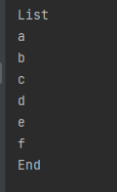
Iterating Over a String
def main():
value = 'abcdef'
print('List')
for el in value:
print(el)
print('End')
main()

Slide 5
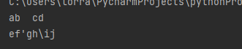
Escape Characters
def main():
print('ab\tcd\nef\'gh\\ij')
main()
\t tab
\n new line
\’ to print ‘
\” to print “
\\ to print \
# print over 2 lines of code
def main():
print('the name of the town is', \
'Athlone’)
main()

Slide 6
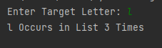
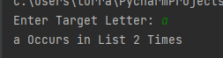
Ex71_ Complete method ‘countLetter’ Ex71_skel.py
def main():
word = 'ballinasloe'
target = str(input('Enter Target Letter: '))
result = countLetter(word, target[0])
print('{0} Occurs in List {1} Times'.format(target[0], result))
‘ballinasloe’
def countLetter(word, tar):
return 0
main()
countLetter(‘meelick’, ‘e’) = 2

Slide 7
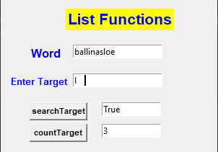

Ex72_ Complete method ‘searchLetter’ Ex72_skel.py
def searchLetter(list,target):
// to be completed
def countLetter(word, tar):
result = 0
for el in word:
if el==tar:
result += 1
return result

Slide 8
String Methods:
words.split(‘ ‘) - splits a sentence into a list of words
s.count(substr) - counts number of times substr occurs in s
s.find(substr) - returns start index if substr occurs in s, -1 if not in the list
s.lower() - converts all letters to lowercase
s.upper() - converts all letters to uppercase
s.lstrip(substr) - remove leading white spaces
s.rstrip(substr) - remove trailing white spaces
s.replace(sub1,sub2) - replaces all occurrences of sub1 with sub2
word=“Hello John”
word.replace(“Hello”, “Hi”) - “Hi John”
s.join(list) - combine list as a string with s as a seperator
“ “.join(“The”, “big”,”house”) -> “The big house”
“abc” + “def” -> “abcdef”

Slide 9
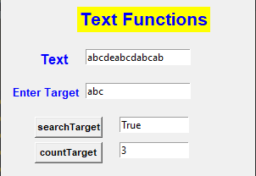
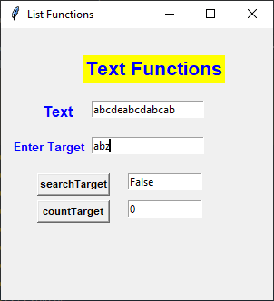
Ex73_ Complete method Ex73_skel.py
def searchSubstr(text,tar):
// returns True if tar occurs in text
def countSubstr(text, tar):
// returns Number of times tar occurs in text

Slide 10
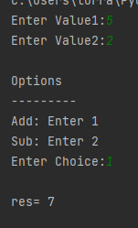
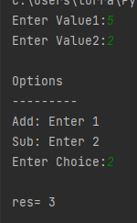
Enumerated Types # Help Readability of code
from enum import IntEnum
class Shape(IntEnum):
Add = 1
Sub = 2

Slide 11
Enumerated Types
def main():
x = int(input('Enter Value1:'))
y = int(input('Enter Value2:'))
print('\nOptions')
print('---------')
print('Add: Enter {0}'.format(Shape.Add))
print('Sub: Enter {0}'.format(Shape.Sub))
choice = int(input('Enter Choice:'))
if (choice== Shape.Add):
print("\nres=", (x+y))
elif (choice== Shape.Sub):
print("\nres=", (x-y))
main()

Slide 12
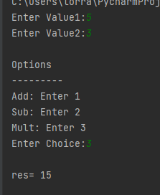
Ex74_ Enumerated Types Ex74_skel.py
Add one additional Option to enum type)
For Mult
Shape.Mult

